Slide 1
Meta-learning via Language Model In-context Tuning
ACL 2022
51255901073 李雍

Slide 2
Meta-Learning
•learning to learn: 面向的不是学习的结果，而是学习的过程
•Example（教小朋友读英语）:
1）让他们模仿apple、banana的发音 ====> strawberry ？
2）不教每个单词的发音，而是教音标的发音 ====> strawberry ！
学习音标的过程，正是一个元学习的过程。
•learning to adapt to a new task : 学习如何适应新任务

Slide 3
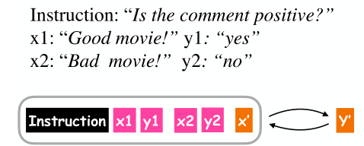
Motivation
•LMs suffer from:
1）recency bias
2）example choices
3）instruction wording

Slide 4
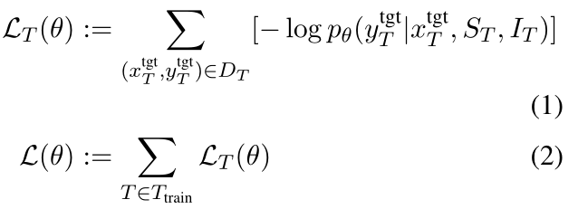
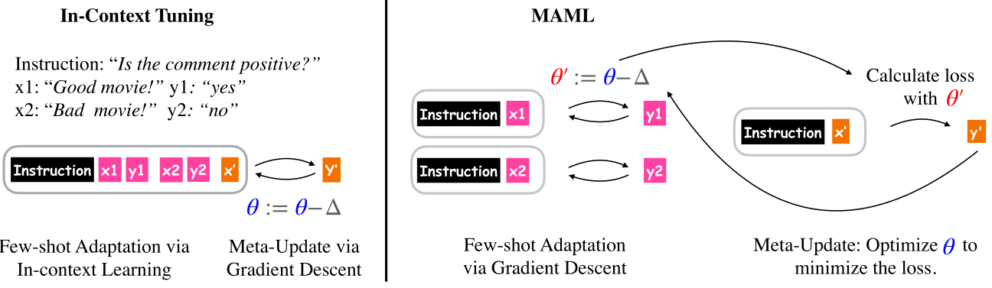
Method
•In-context Tuning
1) model input = task instruction + task input-output pairs + task input
2) no gradient update is performed during adapting to a new task

Slide 5
Method
•Gradient-based Task Adaptation
1) Instruction Tuning + Fine-tuning
2) MAML

Slide 6
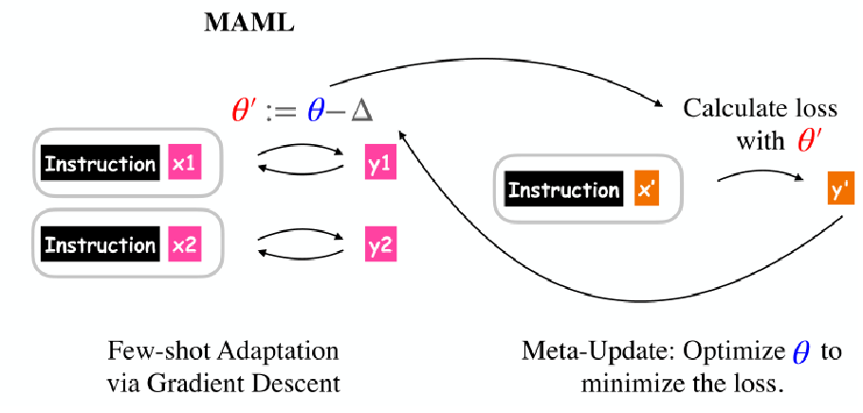

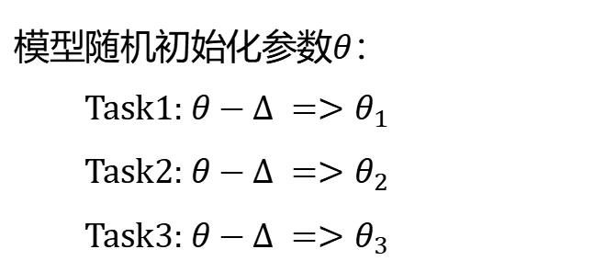



Method
•Gradient-based Task Adaptation
1) Instruction Tuning + Fine-tuning ≈ zero-shot adaptation via In-context Learning
2) MAML
模型随机初始化参数$θ$：
Task1: $θ−∆ =>θ_{1}$
Task2: $θ−∆ =>θ_{2}$
Task3: $θ−∆ =>θ_{3}$
test
$${loss}_{1}$$
test
$${loss}_{2}$$
$$θ−∆ =>θ$$
test
$${loss}_{3}$$
第一种梯度下降
第二种梯度下降
•unstable, sensitive to hyperparameters
•computationally expensive

Slide 7
Experimental
•Baselines:
1) Raw In-context Learning (Raw IC-L):
directly evaluate a raw LM on a new task; without fine-tuning the LM on any labeled data
2) Instruction Tuning (InsT):
zero-shot learning
•Datasets:
1) LAMA (filtered):
① 29 relations(tasks) and 12k (subject, relation, object) examples ; ② 21k-way classification;
③ partition the 29 tasks into 8 groups; ④ six for training, one for validation, one for testing
2) BinaryClfs:
① 203 binary classification tasks; ② each task can be described by 1-4 “yes/no" questions;
③ group the tasks by similarity; ④ with instructions

Slide 8
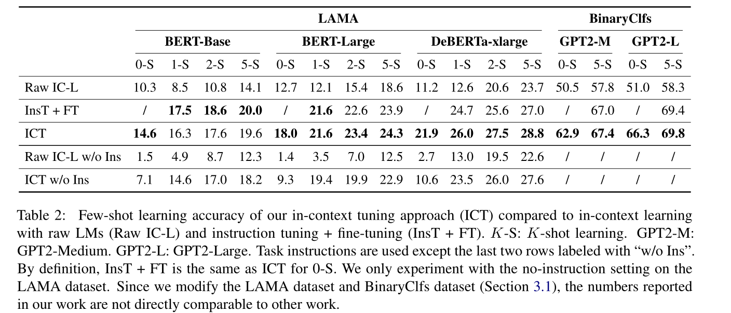
Experimental
[110M]
[340M]
[900M]
[345M]
[774M]
in-context tuning will be increasingly effective for bigger models

Slide 9
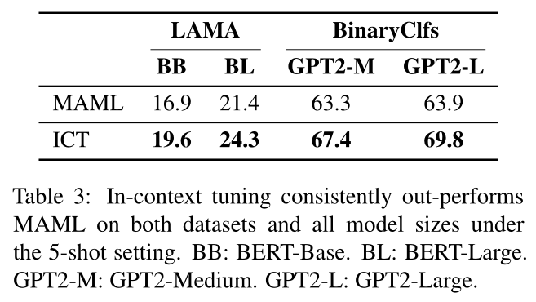
Experimental

Slide 10
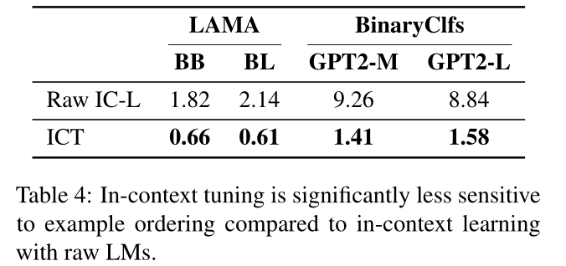
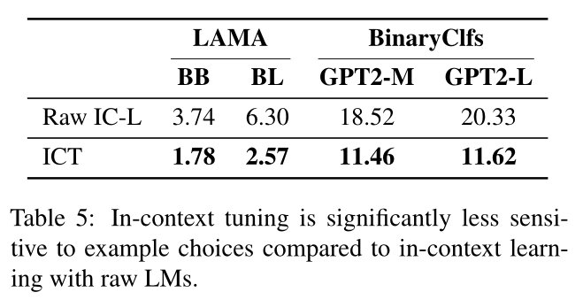
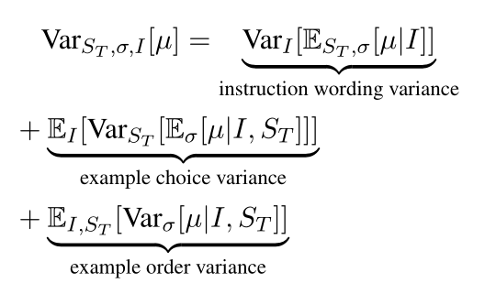
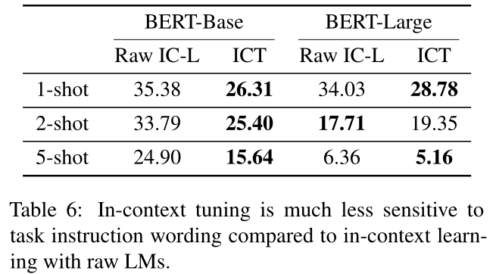
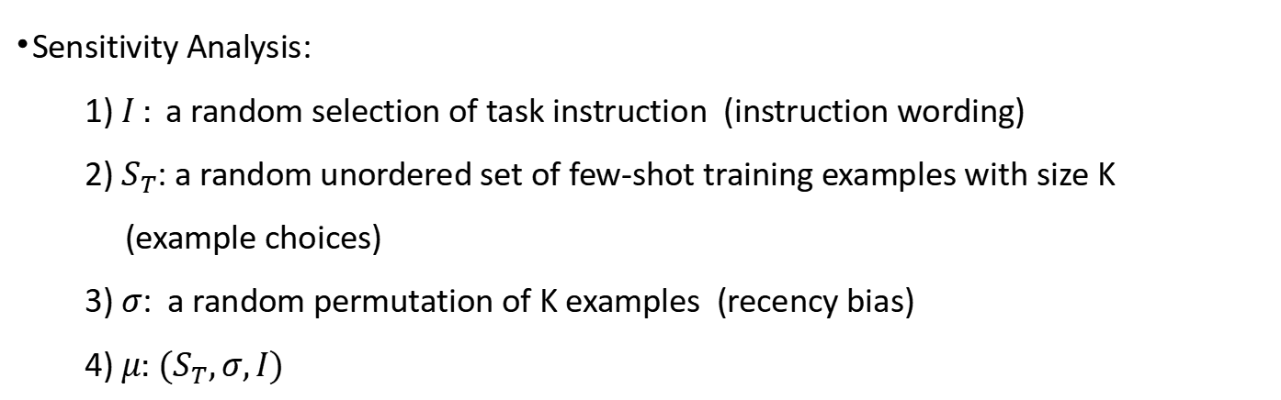
Experimental
•Sensitivity Analysis:
1) $I :$a random selection of task instruction (instruction wording)
2) $S_{T}$: a random unordered set of few-shot training examples with size K
(example choices)
3) $σ$: a random permutation of K examples (recency bias)
4) $μ:$ $(S_{T},σ,I)$

